Slide 1
SELECTOR MADNESS: BUILDING “stable” SELECTORS
John Stennett
Team Pangolins
Twitter: @john_stennett

Slide 2
Today’s Agenda
Browser Add-Ons
General Questions
Do’s and Don’ts
CSS Overview
XPATH Overview
Questions
Resources
Replicating CSS in XPATH

Slide 3

GENERAL WARNINGS
I’m not a “Master of Selectors”.
1
Alex Kolesnyk schools me in Xpath selectors often.
We are only scratching the surface of what you can do with selectors.
2
There are a lot of tables in this presentations. Sorry.
3
Notes:
Slightly more advanced then others. I learned a lot researching this presentation. Unless I’ve had a few to drink, then I may be “Master of Selectors”. Sorry….
Lots of info to display, had to use a table or create a hundred slides.

Slide 4

Browser Add-Ons
Notes:
I’m a super visual person so I use a few Add-Ons that allow me to isolate Selectors on the page as a I build them.
Please install them after the presentation. Enjoy!

Slide 5
BROWSER Add-Ons
Chrome
- Live Preview of CSS/Less/Sass
- Xpath Helper
FireFox
- Live editor for CSS and LESS
- Try Xpath
Notes:
CSS Tools
Chrome:
Live preview of CSS/Less/Sass code with an in-page editor. Autocomplete, Less/Sass to CSS, beautify, minify, CSS reloader, lint: https://chrome.google.com/webstore/detail/live-editor-for-css-less/ifhikkcafabcgolfjegfcgloomalapol
FireFox:
Live editor for CSS and LESS: https://addons.mozilla.org/en-US/firefox/addon/live-editor-for-css-and-less/?src=search
XPATH Tools
Chrome:
XPath Helper: https://chrome.google.com/webstore/detail/xpath-helper/hgimnogjllphhhkhlmebbmlgjoejdpjl
FireFox:
Try XPath: https://addons.mozilla.org/en-US/firefox/addon/try-xpath/?src=search

Slide 6
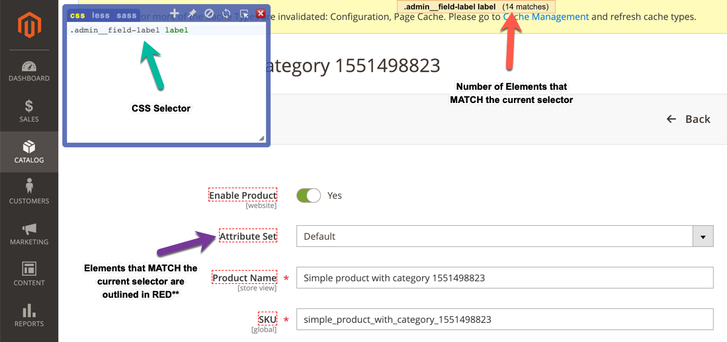
Live Preview of CSS/Less/Sass
Notes:
** So times you will enter a selector, it will say that it “found” 1 or more elements, but it doesn’t highlight anything. This is because you are trying to select something not “visible”.

Slide 7
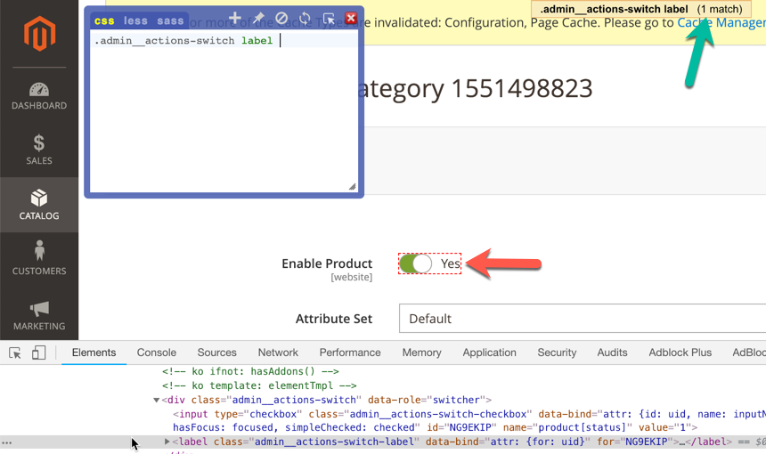
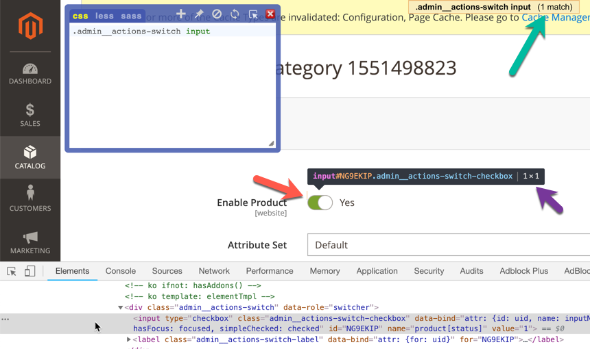
Live Preview of CSS/Less/Sass**

Slide 8
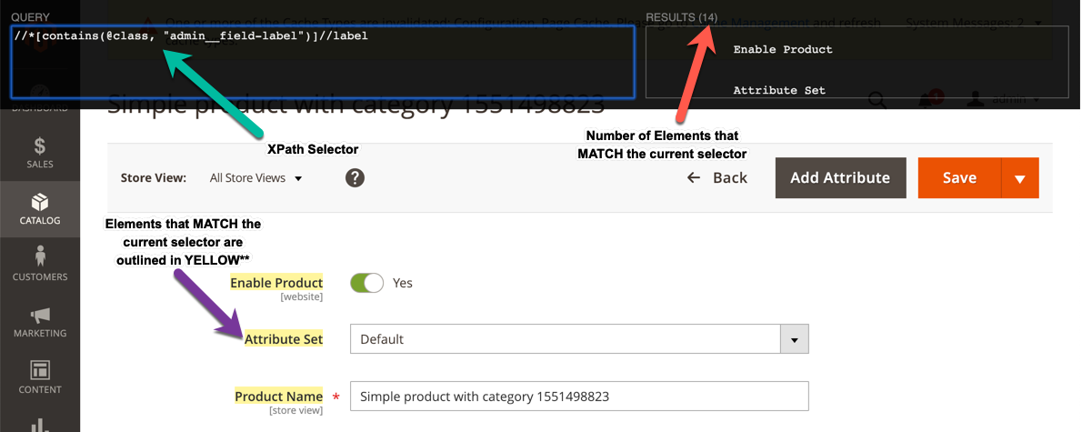
Xpath Helper

Slide 9
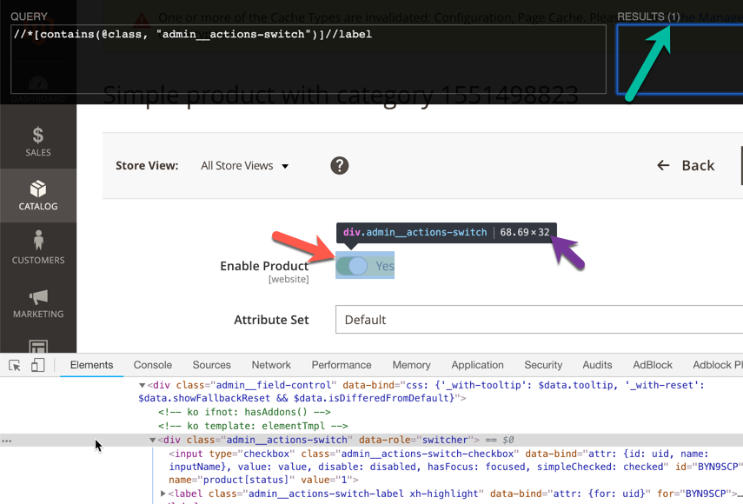
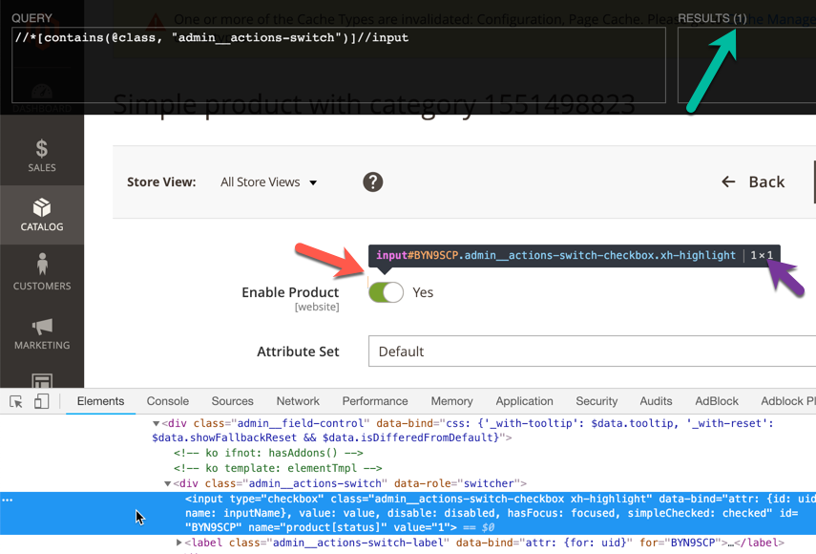
Xpath Helper**

Slide 10
General questions

Slide 11
Why are we talking about selectors?
While reviewing Tests & Section Objects I’ve ran across selectors that make me…
Notes:
In my review of existing Section Objects I have discovered incredibly explicit and brittle selectors being used. I'd like to help prevent these types of selectors from getting introduced in the future.

Slide 12
Which selectors?
#1
div[data-role=“banner”] .pagebuilder-mobile-hidden[style*=“40px calc(50% + 40px) 40px 40px”][style*=“magento”]
#2
(//div[contains(@class,”pagebuilder-buttons”)])[{{arg1}}][@style=“border: {{arg2}}; border-radius: {{arg3}}px; margin: {{arg4}}px; padding: {{arg5}}px;”]
#3
//div[contains(@style,”padding: {{arg1}}”)]
#4
//div[contains(@class, “admin__data-grid-action-bookmarks”)]/ul/li/div/a[text() = “{{label}}”]
Notes:
CSS properties change often => unstable, one of the last resort methods.
Parameterized CSS properties is a bit better, but still bad, especially with the number of properties outlined.

Slide 13
Remember, when it comes to selectors…
“Less is more” [most of the time]
- Robert Browning
“Keep It Simple, Stupid”
- U.S. Navy 1960’s
Notes:
Yea it’s from a poem that doesn’t deal with selectors.
Poem “Andrea del Sarto”
https://www.poetryfoundation.org/poems/43745/andrea-del-sarto

Slide 14
Which is better CSS or Xpath?
CSS is more stable, easier to read/write* and maintain (typically).
Xpath provides several powerful tools and it’s been around the longest so it’s well documented.
Xpath can be less stable and potentially unsupported by certain actions in Selenium.
Notes:
In my opinion CSS is easier to write and read.
Take the easier path before diving into the hard path, you can waste a lot of energy by doing it the hard way, everytime.

Slide 15
What is the priority for selectors?
1st – ID, Class, Name or anything else that is unique
2nd – Complex CSS selectors
3rd – Xpath selectors
n^{th} – Ask the Developer to add a unique ID or Class

Slide 16
Why are WE STILL talking about Xpath?
Unsupported CSS Pseudo Selectors
in the latest version of Selenium (v3.141.5)*:
:first
:contains
:has
Unsupported CSS Pseudo Selectors
in previous versions of Selenium**:
:first-of-type
:last-of-type
:nth-of-type(n)
:only-of-type
:first-child
:last-child
:nth-child(n)
:only-child
:empty
Notes:
Great question. I ask myself that on a daily basis.
Because Selenium doesn’t support the more complex and useful CSS Pseudo Selectors.
Not a full selector engine.
The following pseudo-class selectors are NOT supported at this time, you will receive a "CSS or XPath locator is malformed" error if they are used:
:first
:contains
:has
The following pseudo-class selectors appear to NOT be fully supported at this time, you will receive the following assert error: "Failed asserting that an array is not empty."
:first-of-type
:last-of-type
:nth-of-type(n)
:only-of-type
:first-child
:last-child
:nth-child(n)
:only-child
:empty
IF you need to use one of the above pseudo-class selectors you will need to utilize XPath instead of CSS.
Luckily you can replicate these selector functions in XPATH. We will dive into these more later.
<test name="ExperimentTest"> <annotations> <stories value="Experiment Test 1"/> <title value="Experiment Test 1"/> <description value="Experiment Test 1"/> <severity value="CRITICAL"/> <testCaseId value="#"/> <group value="banana"/> </annotations> <!--Login as admin --> <actionGroup ref="LoginAsAdmin" stepKey="loginToAdminPanel"/> <seeElement selector="a:first" stepKey="seeSomething1"/> <seeElement selector="a:contains('Dashboard')" stepKey="seeSomething2"/> <seeElement selector="div:has(> h1)" stepKey="seeSomething3"/> <seeElement selector="div h1:first-of-type" stepKey="seeSomething4"/> <seeElement selector="div h1:last-of-type" stepKey="seeSomething5"/> <seeElement selector="div h1:nth-of-type(1)" stepKey="seeSomething6"/> <seeElement selector="div h1:only-of-type" stepKey="seeSomething7"/> <seeElement selector="div h1:first-child" stepKey="seeSomething8"/> <seeElement selector="div h1:last-child" stepKey="seeSomething9"/> <seeElement selector="div h1:nth-child(1)" stepKey="seeSomething10"/> <seeElement selector="div h1:only-child" stepKey="seeSomething11"/> <seeElement selector=".admin__menu-overlay:empty" stepKey="seeSomething12"/> </test>

Slide 17
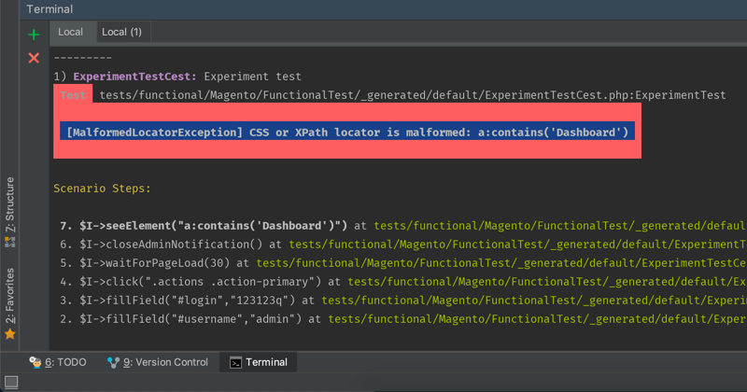
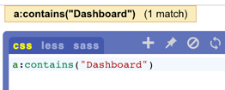
What Happens IF you Use Them?
Notes:
The CSS add-on can locate some of the elements but don’t outline them.
Error message that appears in PHP Storm when you use them, well in terminal when used with selenium.

Slide 18
DO’s and Don’ts

Slide 19
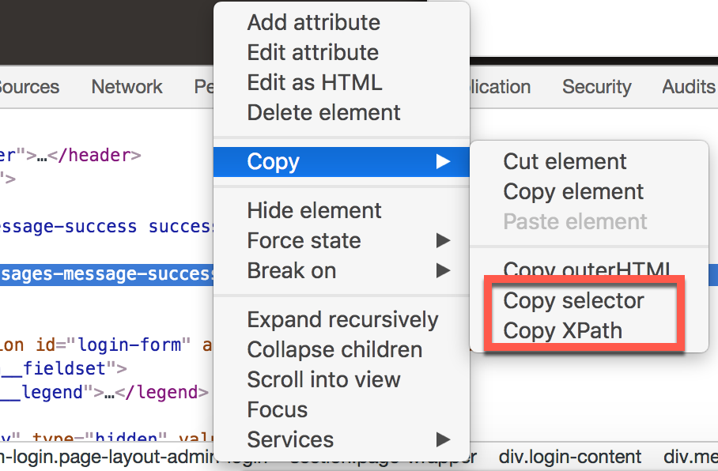
Don’t #1
DO NOT right click on an Element in the “Browser Inspector” and select ’Copy selector’ or ’Copy Xpath’.
‘Copy selector’ results:
#html-body > section > div > div > div > div
‘Copy Xpath’ results:
//*[@id="html-body"]/section/div/div/div/div
Notes:
PLEASE NOTE: The above selectors that are generated are WAY to specific to be considered “stable”. If ANY element in the provided path changes the entire selector will be invalid.

Slide 20
Don’t #2
Don’t make your selectors too generic.
Examples
input[name*="firstname"]
.add
.save
Notes:
If you do this you may target multiple elements that can make your test unstable. Sometimes the test may work other times it will fail.
e.g.
You could have a Test that clicks on the ”Save” button and it works in most cases, then in others it breaks. It’s most likely caused by the page getting to be too long and the 2nd element instead of the 1st one. In these screenshots, if you didn’t interact with the elements on the lower part of the page for most tests, then you have a test that scrolls down the page, it will start to fail because it automatically targets the 1st element, so the “Top Bar” would receive the click in this case. Even thought the “Save” button is ‘present’.

Slide 21
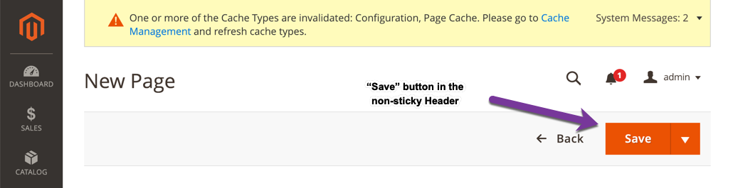
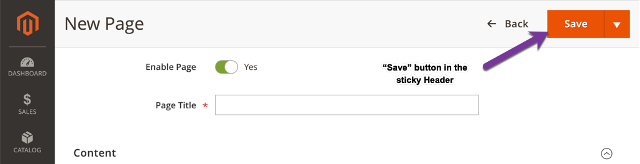
Don’t #2 EXAMPLE

Slide 22
Don’t #3
Don’t make your selectors too specific either.
Examples
#container .dashboard-advanced-reports .dashboard-advanced-reports-description .dashboard-advanced-reports-title
//*[@id='container']/*[@class='dashboard-advanced-reports']/*[@class='dashboard-advanced-reports-description']/*[@class='dashboard-advanced-reports-title']
Notes:
These selectors could be too brittle and would break if a single things changes in the given path.

Slide 23
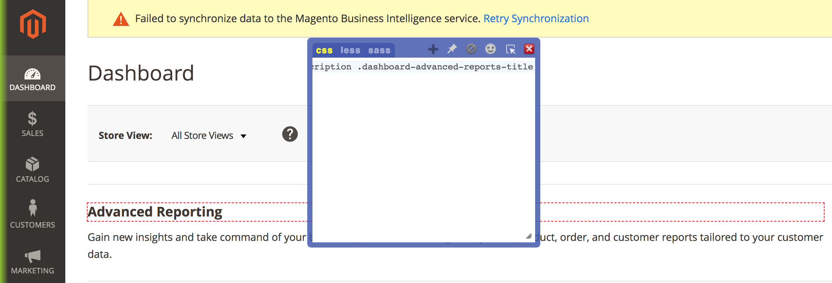
Don’t #3 EXAMPLE

Slide 24
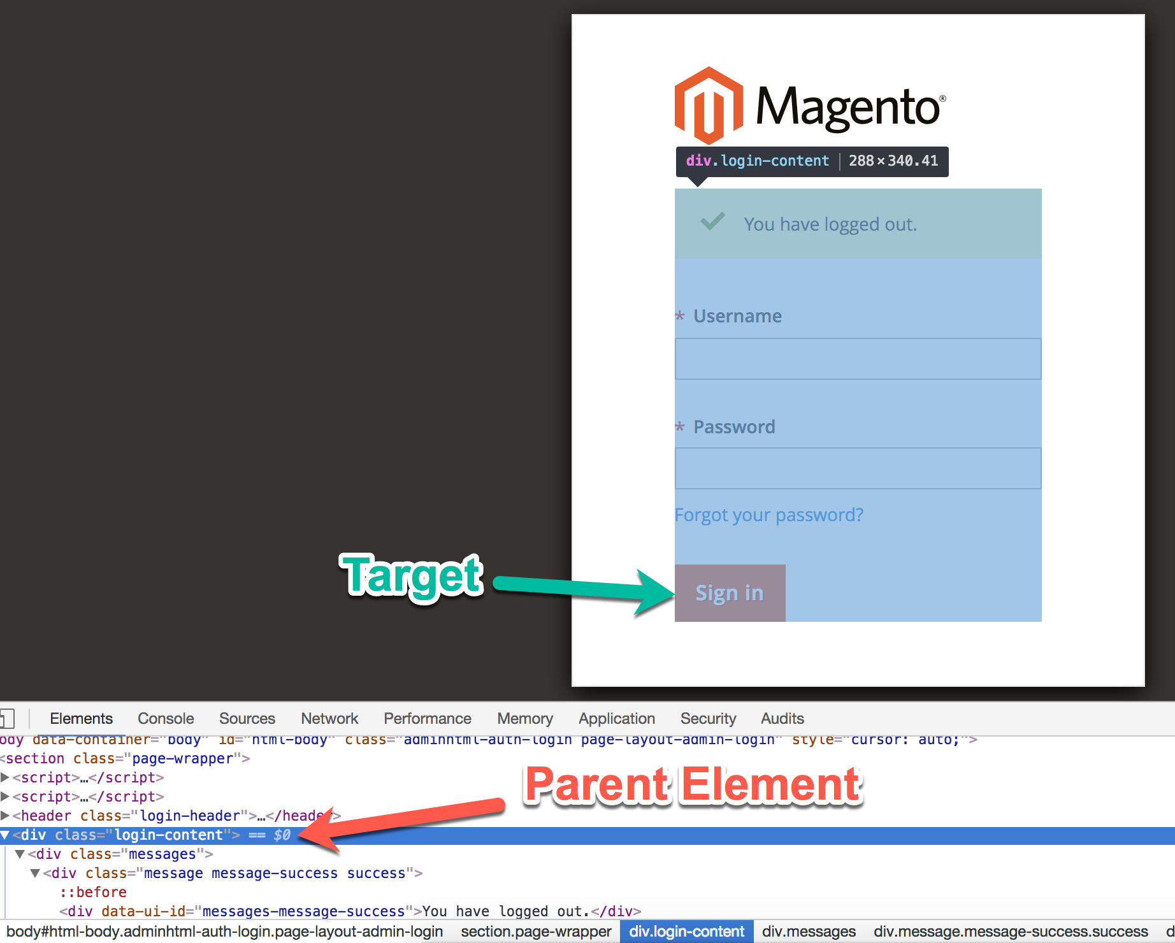
DO #1 – ISOLATION
Think ”Isolation”:
Isolate the parent element 1st
Then target the child element under the parent element
This reduces the amount of DOM that you need to worry about

Slide 25
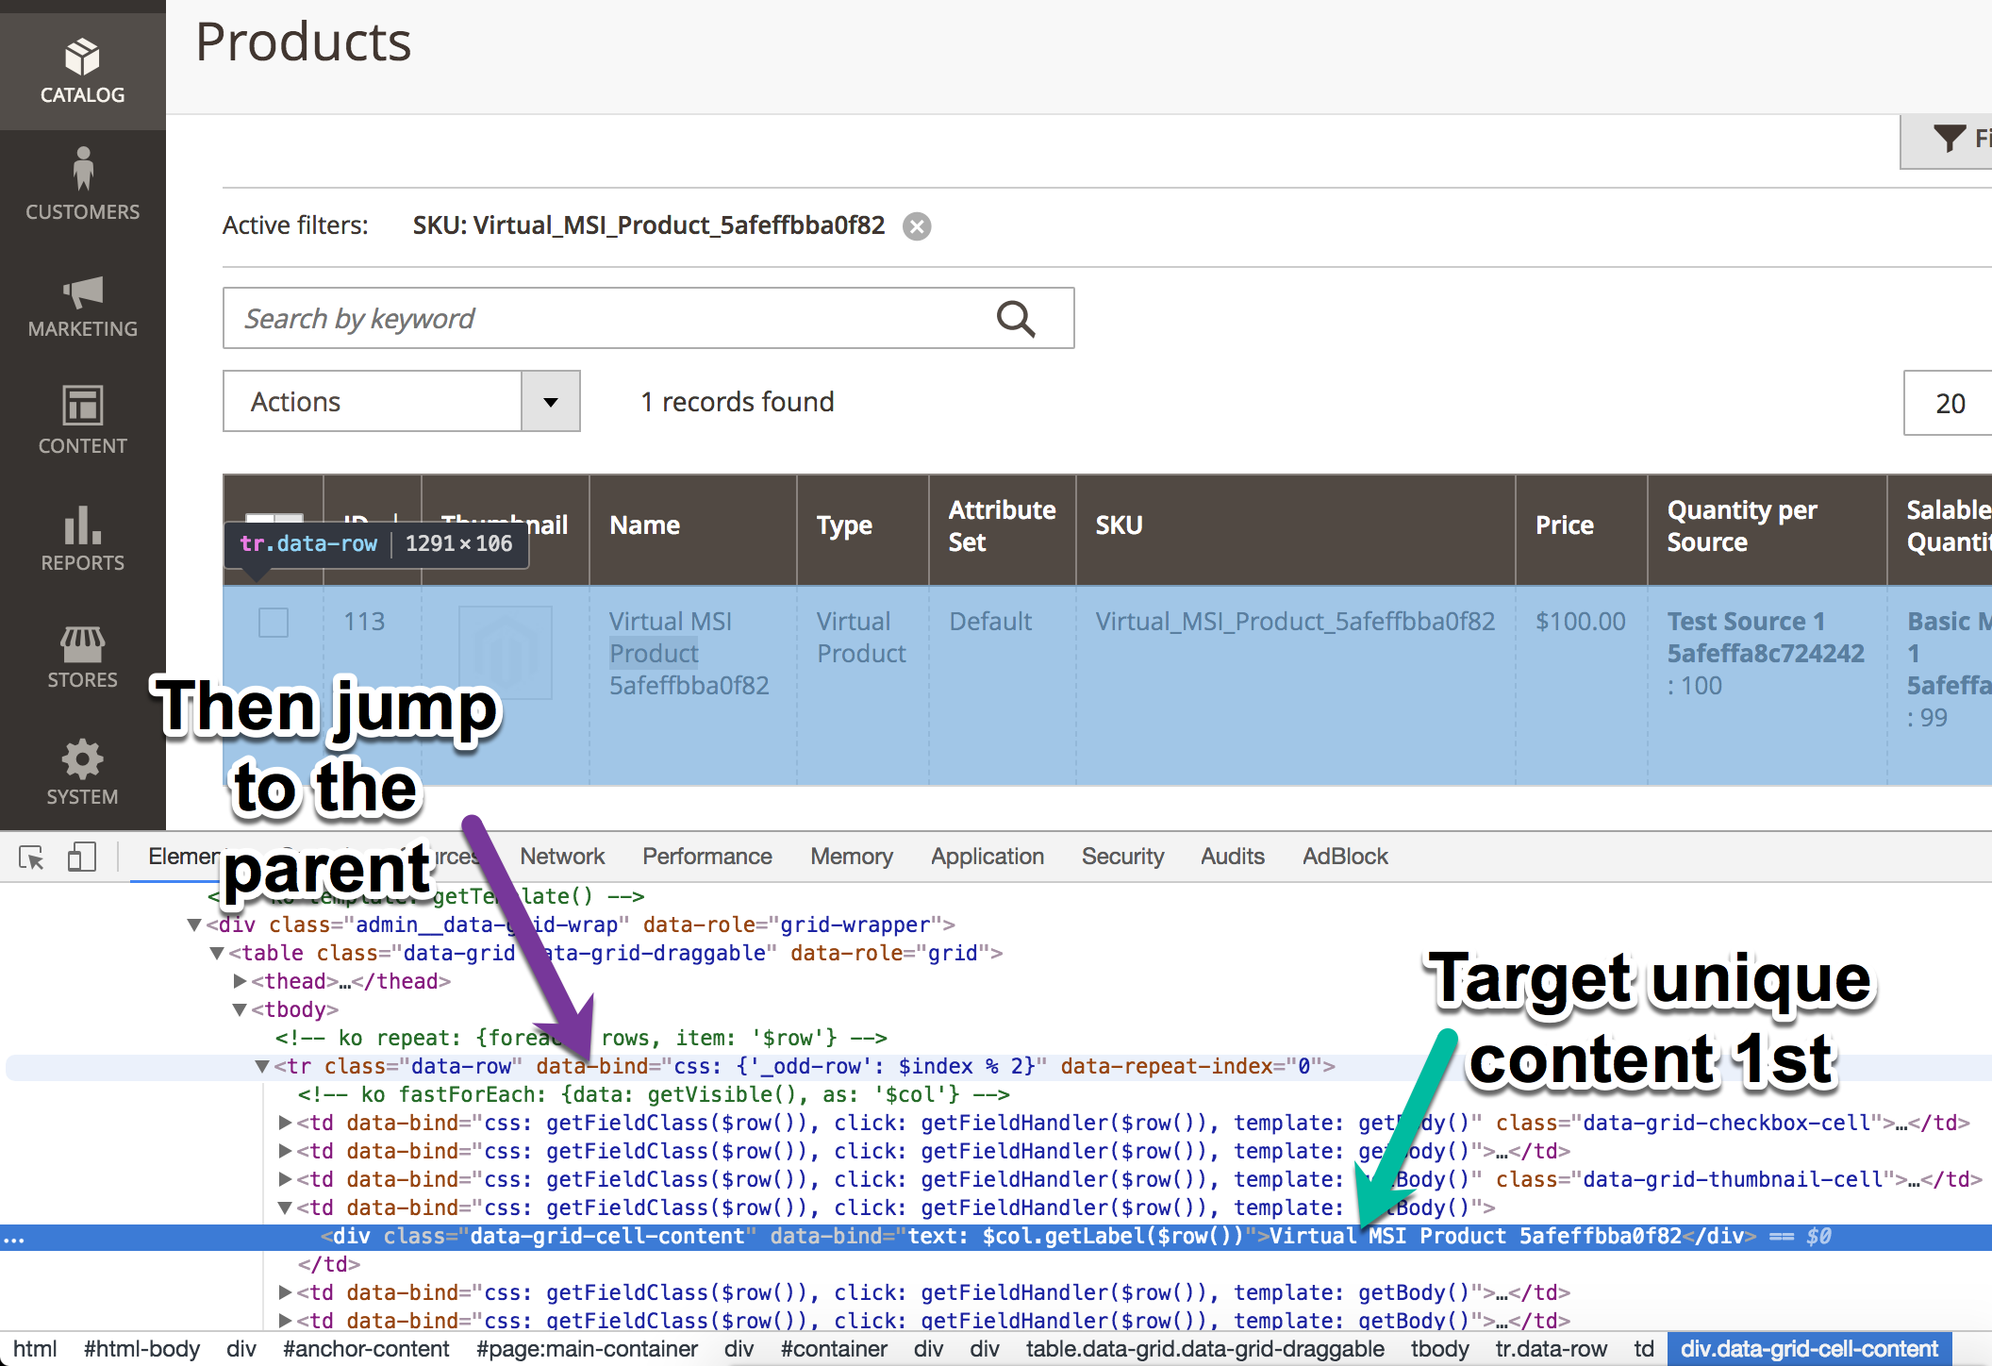
DO #2 – Reverse ISOLATION
IF you need to interact with the parent element but it’s too generic, AND the internal contents are unique:
Target the unique internal content 1st
Then Jump to the parent element

Slide 26
CSS Overview
Notes:
Now let’s jump into some CSS. With lots of Tables. Hurray tables.

Slide 27
General CSS Selectors
TYPE | HTML | SELECTOR
ID’s | <div id="idname"/> | #idname {}
Classes | <div class="classname"/> | .classname {}
HTML Tags | <div/> | div {}
HTML Tag & ID | <div id="idname"/> | div#idname {}
HTML Tag & Class | <div class="classname"/> | div.classname {}
ID & Class | <div id="idname" class="classname"/> | #idname.classname {}
HTML Tag & ID & Class | <div id="idname" class="classname"/> | div#idname.classname {}
Notes:
There are a lot of other combos that include the attribute operators but more on them in a few.

Slide 28
CSS Selector Operators
SYMBOL | NAME | PURPOSE | SELECTOR
* | Universal Selector | Allows you to select ALL ELEMENTS on the Page. Wild Card. | * {}
Whitespace | Descendant Combinator | Allows you to combine 2 or more selectors. | #idname .classname {}
> | Child Combinator | Allows you to select the top-level elements THAT FOLLOWS another specified element. | #idname > .classname {}
+ | Adjacent Sibling Combinator | Allows you to select an element THAT FOLLOWS DIRECTLY AFTER another specified element. | #idname + .classname {}
~ | General Sibling Combinator | Allows you to select an element THAT FOLLOWS (directly or indirectly) another specified element. | #idname ~ .classname {}
Notes:
Universal Selector - Works like a wild card character selecting all elements on the page.
Descendant Combinator - Allows you to combine two or more selectors so you can be more specific in your selection method.
Child Combinator - Allows you to select the top-level elements that follows another specific element.
Adjacent Sibling Combinator - Allows you to select an element that is directly after another specific element.
General Sibling Combinator - Allows you to select an element that follows (Doesn't need to be directly after) another specific element.

Slide 29
CSS Attribute Selector OPERATORS
SYMBOL | PURPOSE | EXAMPLE
= | Returns all elements that CONTAIN the EXACT string in the value. | [attribute=“value”]
|= | Returns all elements that CONTAINS or STARTS WITH the substring in the value. | [attribute|=“value”]
*= | Returns all elements that CONTAINS the substring in the value. | [attribute*=“value”]
~= | Returns all elements that CONTAINS the given words delimited by spaces in the value. | [attribute~=“value”]
$= | Returns all elements that ENDS WITH the substring in the value. | [attribute$=“value”]
^= | Returns all elements that BEGIN EXACTLY WITH the substring in the value. | [attribute^=“value”]
!= | Returns all elements that either DOESN’T HAVE the given attribute or the value of the attribute is NOT EQUAL to the value. | [attribute!=“value”]

Slide 30
XPATH OVERVIEW

Slide 31
/ vs //
NAME | SYMBOL | SELECTOR
Absolute XPath Selectors | / | /html/body/div[2]/div/div[2]/div[1]/div[2]/form/div/input
Relative XPath Selectors | // | //div[@class=“form-group”]//input[@id=“user-message”]
Notes:
Absolute XPath Selectors: /
Starts with a single /
Direct path to the element from the root element
Incredibly brittle
Relative XPath Selectors: //
Starts with double //
Start anywhere in the HTML DOM
Shorter than Absolute XPath selectors
Less brittle

Slide 32
..
NAME | SYMBOL | HTML | SELECTOR
Parent Selector | .. | <tr> <td> <div>Unique Value</div> </td> </tr> | //*[text()=“Unique Value”]/../..
Parent Selector | .. | <tr> <td> <a href=“#”>Edit</a> </td> <td> <div>Unique Value</div> </td> </tr> | //div[text()=“Unique Value”]/../..//a

Slide 33
ATTRIBUTE SELECTORS
Allows you to select an element that contains a specific attribute or a value in a specific attribute.
SYNTAX
//*[@attribute]
//*[@attribute=“value”]

Slide 34
ATTRIBUTE SELECTORS EXAMPLES
ATTRIBUTE | HTML | SELECTOR
ID | <div id=“idname”/> | //*[@id=“idname”]
Class | <div class=“classname”/> | //*[@class=“classname”]
Type | <button type=“submit”/> | //*[@type=“submit”]
Value | <input value=“value”/> | //*[@value=“value”]
HREF | <a href=“https://google.com”/> | //*[@href=“https://google.com”]
SRC | <img src=“/img.png”/> | //*[@src=“/img.png”]
Notes:
Please note: text() is a perfect match only.

Slide 35
CONTAINS() SELECTOR
Allows you to select an element that contains a specific attribute or a value in a specific attribute.
SYNTAX
//*[contains(@attribute, “”)]
//*[contains(@attribute, “value”)]

Slide 36
CONTAINS() SELECTOR EXAMPLES
ATTRIBUTE | HTML | EXAMPLE
text() | <p>Hello World!</p> | //*[contains(text(), “Hello”)]
@id | <div id=“idname1234abcd”/> | //*[contains(@id, “idname”)]
@class | <div class=“classname1 classname2”/> | //*[contains(@class, “classname1”)]
@name | <input name=‘inputname’/> | //*[contains(@name, “name”)]
@value | <input value=“value”/> | //*[contains(@value, “value”)]
@href | <a href=“https://google.com”/> | //*[contains(@href, “google.com”)]

Slide 37
Text() Selector
Allows you to select an element that contains a specific string.
SYNTAX
//*[text()=“exact string”]
//*[contains(text(), “substring”)]

Slide 38
Text() Selector EXAMPLES
TYPE | HTML | EXAMPLE
Exact String Matching | <p>CSS Selectors are great!!!</p> <p>CSS Selectors are great.</p> | //p[text()=“CSS Selectors are great!!!”]
Substring Matching | <p>CSS Selectors are great!!!</p> <p>CSS Selectors are great.</p> | //p[contains(text(), “CSS Selectors”)]

Slide 39
Starts-with() Selector
Allows you to select an element that STARTS WITH the substring or contains text that STARTS WITH the substring.
SYNTAX
//*[starts-with(@attribute, “substring”)]
//*[starts-with(text(), ”substring”)]

Slide 40
Starts-With() Selector Examples
ATTRIBUTE | HTML | EXAMPLE
@id | <div id=“unique_id_abcd1234”/> | //*[starts-with(@id, “unique_id”)]
@class | <div class=“unique_class_abcd1234”/> | //*[starts-with(@class, “unique_class”)]
@href | <a href=“https://www.google.com/”/> | //a[starts-with(@href, “https://”)]
text() | <p>Hello World!</p> | //p[starts-with(text(), “Hello“)]

Slide 41
ENDs-with() Selector
Allows you to select an element that ENDS WITH the substring or contains text that ENDS WITH the substring.
SYNTAX
//*[ends-with(@attribute, “substring”)]
//*[ends-with(text(), “substring”)]

Slide 42
ENDs-With() Selector Examples
ATTRIBUTE | HTML | EXAMPLE
@id | <div id=“abcd1234_unique_id”/> | //*[ends-with(@id, “unique_id”)]
@class | <div class=“abcd1234_unique_class”/> | //*[ends-with(@class, “unique_class”)]
@href | <a href=“https://www.google.com/”/> | //a[ends-with(@href, “google.com/”)]
text() | <p>Hello World!</p> | //p[ends-with(text(), “World!”)]

Slide 43
Ancestor:: Selector
Allows you to select an element that CONTAINS a specific element UNDER IT.
SYNTAX
//target_element[ancestor::unique_element[contains(., “value”)]]

Slide 44
Ancestor:: Selector Examples
TARGET | HTML | EXAMPLE
“Edit” Button | SEE SCREENSHOT BELOW | //a[ancestor::tr[contains(., “1551498823”)]]

Slide 45
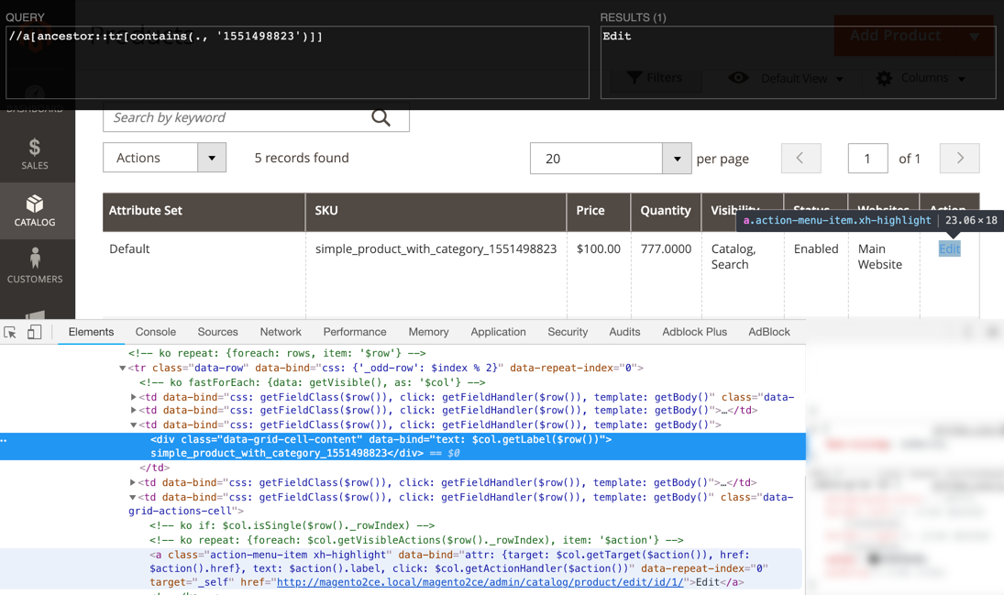

Slide 46
REPLICATING CSS IN XPATH

Slide 47
REPLICATING GENERAL CSS SELECTORS IN XPATH
TYPE | CSS | XPATH
ID’s | #idname {} | //*[@id=“idname”]
Classes | .classname {} | //*[@class=“classname”]
HTML Tags | div {} | //div
HTML Tag & ID | div#idname {} | //div[@id=“idname”]
HTML Tag & Class | div.classname {} | //div[@class=“classname”]
ID & Class (?) | #idname.classname {} | //*[@id=“idname”][@class=“classname”]

Slide 48
REPLICATING Selector Operators IN XPATH
NAME | CSS | XPATH
Universal Selector | * {} | //*
Descendant Combinator | #idname .classname | //*[@id=“idname”]//*[@class=“classname”]
Child Combinator | #idname > .classname | //*[@id=“idname”]/*[@class=“classname”]

Slide 49
Replicating Attribute Selector Operators
SYMBOL | CSS | XPATH
= | a[href=“/”] | //a[@href=“/”]
*= | a[href*=“://”] | //a[contains(@href, “://”)]
~= | input[title~=“help”] | //input[contains(@title, “help”)]
$= | a[href$=“pdf”] | //a[ends-with(@href, “pdf”)]
^= | a[href^=“/”] | //a[starts-with(@href, “/”)]

Slide 50
The End? Not really.
There is a lot more to Selectors!!
Notes:
We scratched the surface of what you can do with Selectors. Xpath has several additional tools that you can use for even more complex selector creation.

Slide 51
Questions?

Slide 52
Resources
CSS
https://devhints.io/css
https://www.w3schools.com/css/
XPATH
https://devhints.io/xpath
https://www.w3schools.com/xml/xpath_intro.asp
CONFLUENCE
https://wiki.corp.magento.com/display/QMT/Selectors
Notes:
CSS
https://devhints.io/css
https://www.w3schools.com/css/
XPATH
https://devhints.io/xpath
https://www.w3schools.com/xml/xpath_intro.asp
Random Articles
https://www.sitepoint.com/css-selectors/
https://www.sitepoint.com/comprehensive-jquery-selectors/
https://www.guru99.com/xpath-selenium.html
https://www.swtestacademy.com/css-selenium/
https://www.swtestacademy.com/xpath-selenium/
https://css-tricks.com/almanac/selectors/
Confluence
Tricky Selector Support

